Slide 1

SMART MEDICINE REMINDER AND VENDING MACHINE
FOURTH INDIVIUAL MEETING: PCB LAYOUT DESIGN
INSTRUCTOR: Prof. Mike Aleshams
Student Name: Nishitha Kodur
Student ID: C0771813

Slide 2
Table of Contents
Introduction
Block Diagram
Popular Open-Source Software for Schematic/PCB Design
Introduction to PCB Layout Design
Importance of PCB Layout Design
Schematic Diagram
About Easy EDA
Easy EDA for PCB Layout Design
PCB Layout Design for the project
3D view of the PCB boards

Slide 3
Introduction
To overcome the problem of forgetting to take medicines in elderly people, we came up with a 'SMART MEDICINE REMINDER AND VENDING MACHINE.
It is an IoT device which reminds and dispenses medicine on time.
In this project , we design and develop a medicine reminder and vending machine using Alexa as a Bluetooth speaker and Raspberry pi.
The machine saves dispense and alarm time, when it is time to dispense the medicine, the machine alarms the user and dispenses the medicine box to the user.

Slide 4
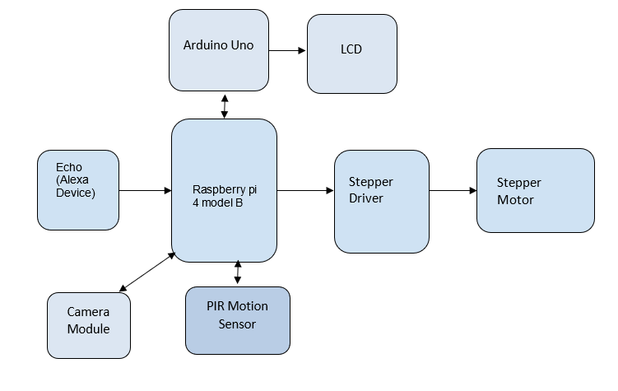
Block Diagram

Slide 5
Popular Open-Source Software for Schematic/PCB Design
Autodesk Eagle
KiCAD
Fritzing
DesignSpark PCB
EasyEDA

Slide 6
Introduction to PCB Layout Design
Printed circuit board (PCB) design brings our electronic circuits to life in the physical form. We will be using Zero-PCB for our project’s PCB implementation.
Zero PCB is basically a general-purpose printed circuit board (PCB), also known as perfboard or DOT PCB.
It is a thin rigid copper sheet with holes pre-drilled at standard intervals across a grid with 2.54mm (0.1-inch) spacing between holes.

Slide 7
Introduction to PCB Layout Design
Each hole is encircled by a round or square copper pad so that component lead can be inserted into the hole and soldered around the pad without short-circuiting the nearby pads and other leads.
For connecting the lead of component with another lead, solder these together or join these using a suitable conducting wire.

Slide 8
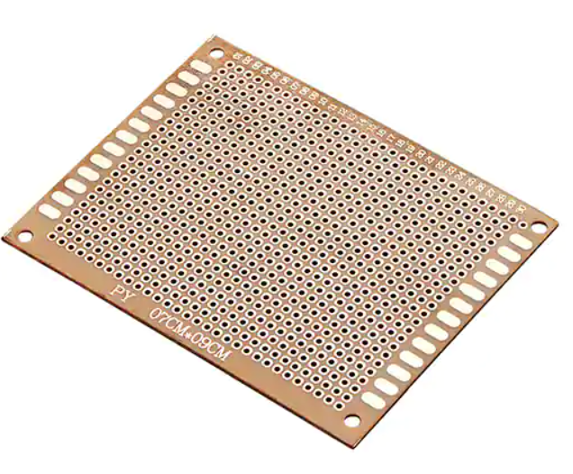
Introduction to PCB Layout Design
Sample Zero-PCB board:

Slide 9
Importance of PCB Layout Design
Designing the layout of the printed circuit board is crucial to creating a reliable, cost-effective board.
While circuit design and component selection are also essential, we should always make sure that we leave enough time for PCB layout.
PCB layout design plays a significant role in ensuring signal integrity and preventing electrical problems such as interference, often referred to as radio-frequency or electromagnetic interference.
An inadequate layout can result in problems such as electromagnetic interference, conflicts from components on either side of the board, limited board functionality and even total board failure.

Slide 10
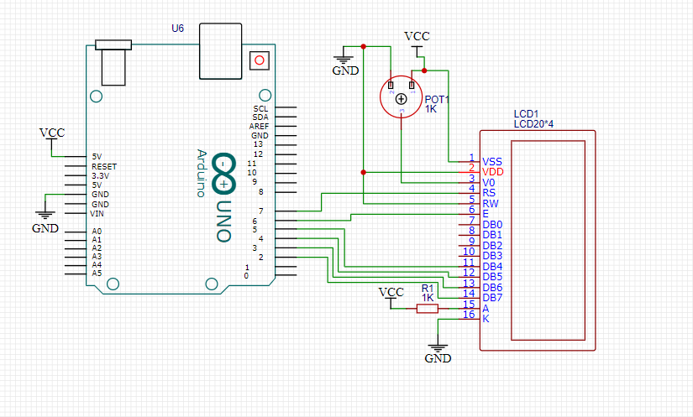
Schematic Design
Part-1: LCD screen is connected to Arduino Uno. Also, a potentiometer is placed to adjust the level of brightness of the LCD.

Slide 11
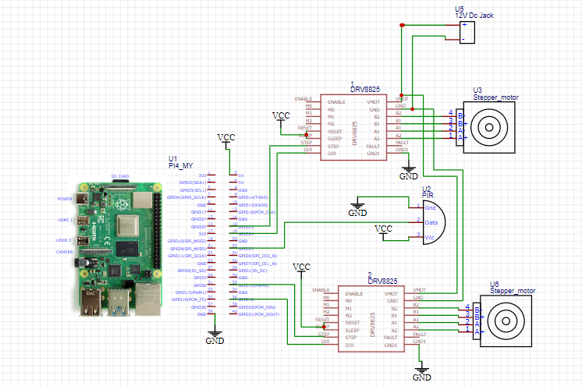
Schematic Design
Part-2: GPIO pins of raspberry pi are connected to stepper motor, stepper drivers and PIR sensor.

Slide 12
About Easy EDA
EasyEDA is a free and a paid EDA tool.
Provides a powerful schematic capture, PCB editor, Libraries designer, a project management tool, and lastly a team collaborator.
It also has an integration with LCSC.com component catalog for providing real-time stocks and pricing information about components used.
EasyEDA is online based and also desktop based.
It is cross-platform and supports Windows, Linux, and Mac.
For designing PCB Layout for our project we chose EASY EDA software based on the above features provided by it.

Slide 13
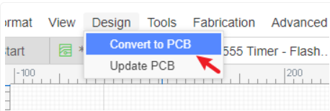
Easy EDA for PCB layout design
EasyEDA’s PCB Design canvas helps us to quickly and easily lay out even complex multilayer designs from schematics we have already created in the Schematic canvas or directly as a layout with no schematic.
Passing an EasyEDA Schematic into the PCB Design editor is as easy as clicking a button: Click the Convert to PCB using: “Menu - Design - Convert to PCB”.

Slide 14
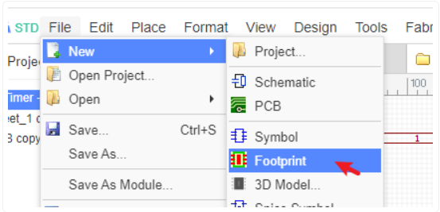
Easy EDA for PCB layout design
EasyEDA has extensive component footprints. We can also build up our own library of unusual and specialized parts by copying and modifying existing parts or from scratch using EasyEDA’s powerful footprint creation and editing tools.

Slide 15
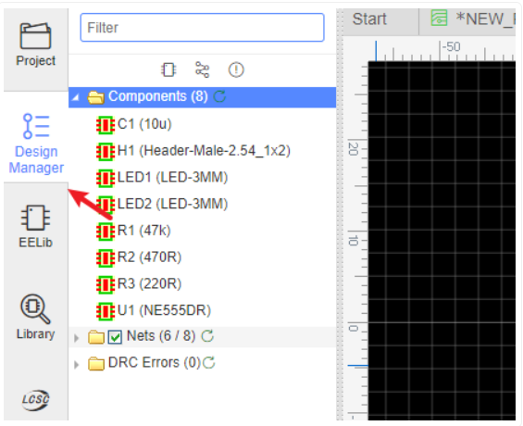
Easy EDA for PCB layout design
When working in the PCB Design canvas there is a PCB Design Manager which works in a similar way to the Schematic design canvas, this will helps us locate items and navigate our way around. Left Navigation Panel > Design Manager
The PCB Design Manager is a powerful tool for finding components, tracks (nets) and pads (Net Pads). Clicking on any item highlights the component and pans it to the center of the window.

Slide 16
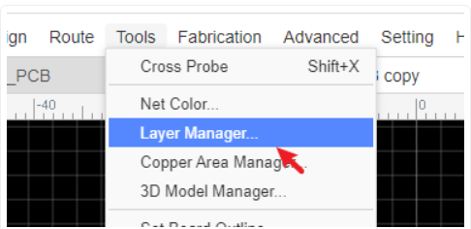
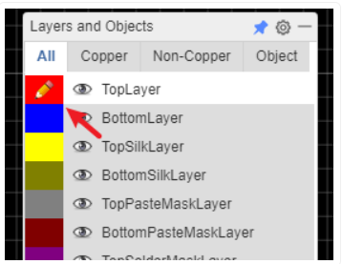
Easy EDA for PCB layout design
We can set up layers used in the PCB and their display colours and visibility using Top Menu - Tools - Layer Manager…
The active layer and layer visibility can be selected using the Layers Toolbar.

Slide 17
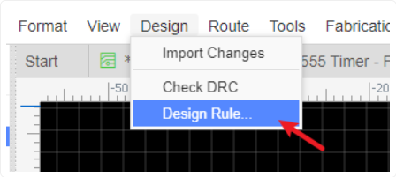
Easy EDA for PCB layout design
Default track widths, clearances and via hole dimensions can all be configured in the Design Rule Check dialog which is opened by: Top Menu > Design > Design Rule…
The Design Rule Check (DRC) is created when beginning the board layout. It can also be modified at any time. Running a DRC is one of the last steps in checking the PCB design before we start forming the tracks and soldering components on Zero-PCB.

Slide 18
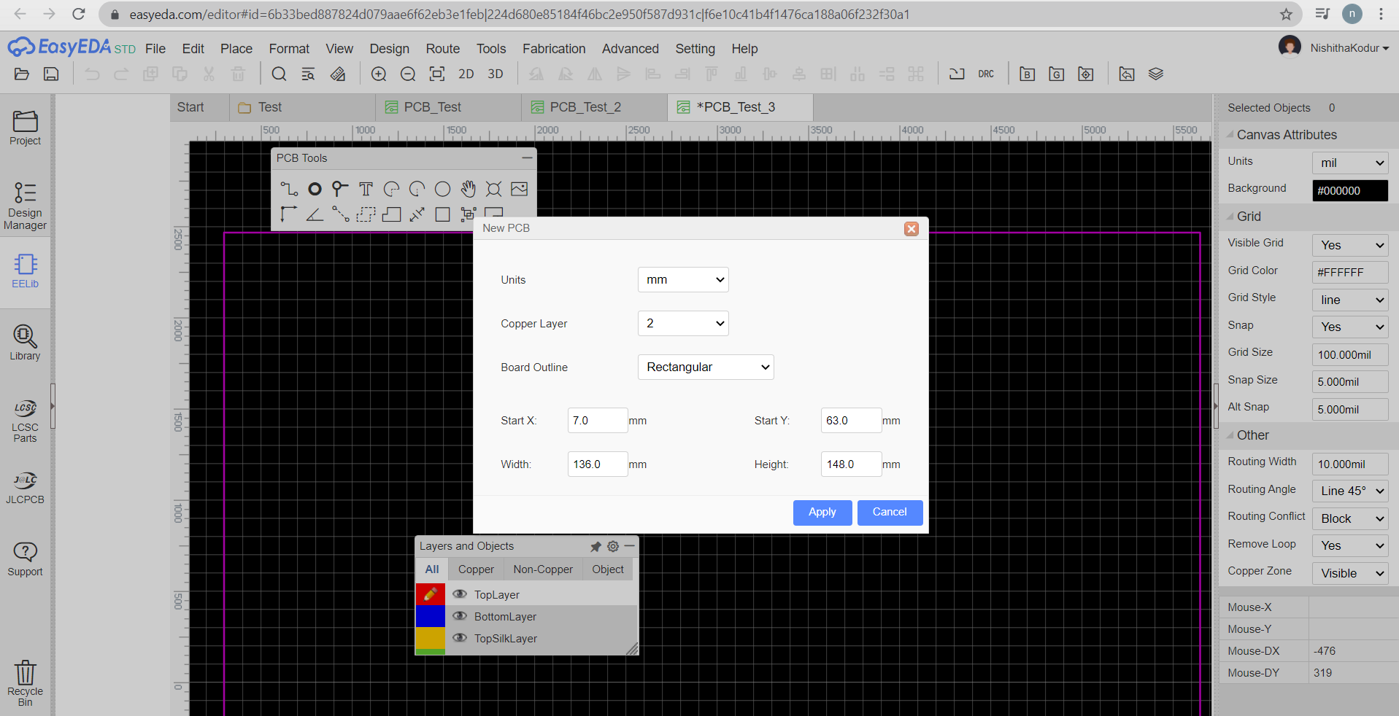
Easy EDA for PCB layout design
Designing PCB: Click Apply in the below window. This is the dimensions required for the PCB board. We can either select the default dimensions or we can give our required dimensions.

Slide 19
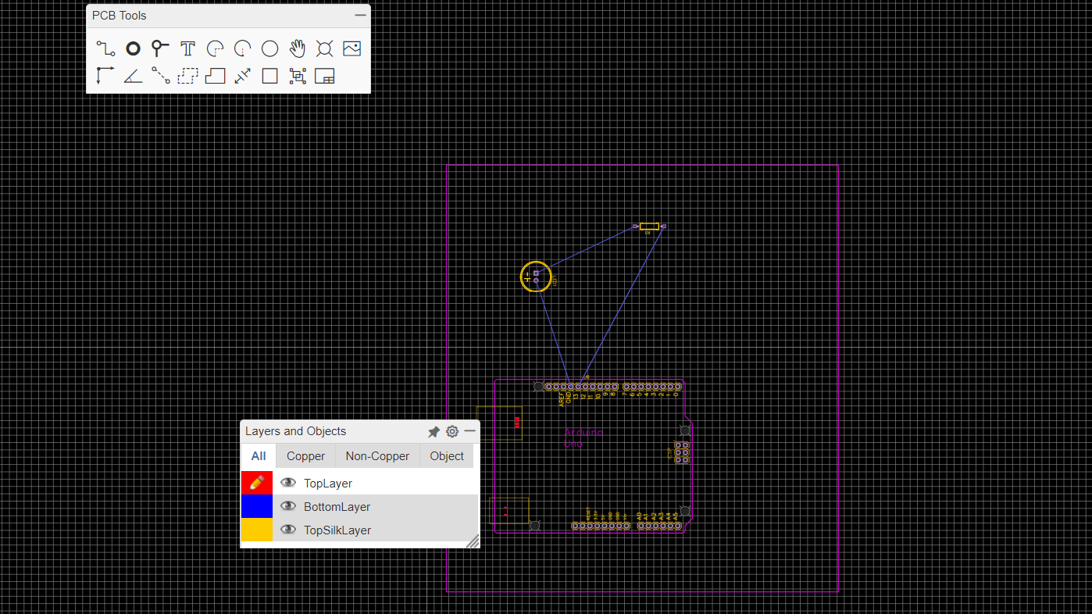
PCB Layout Design for the project
Drag and place the components in the purple square. To adjust the components if twisted, use the Rotate Right or Rotate left options available on the menu bar by clicking on the component.
Connect the components by drawing the tracks using wither bottom layer or top layer.

Slide 20
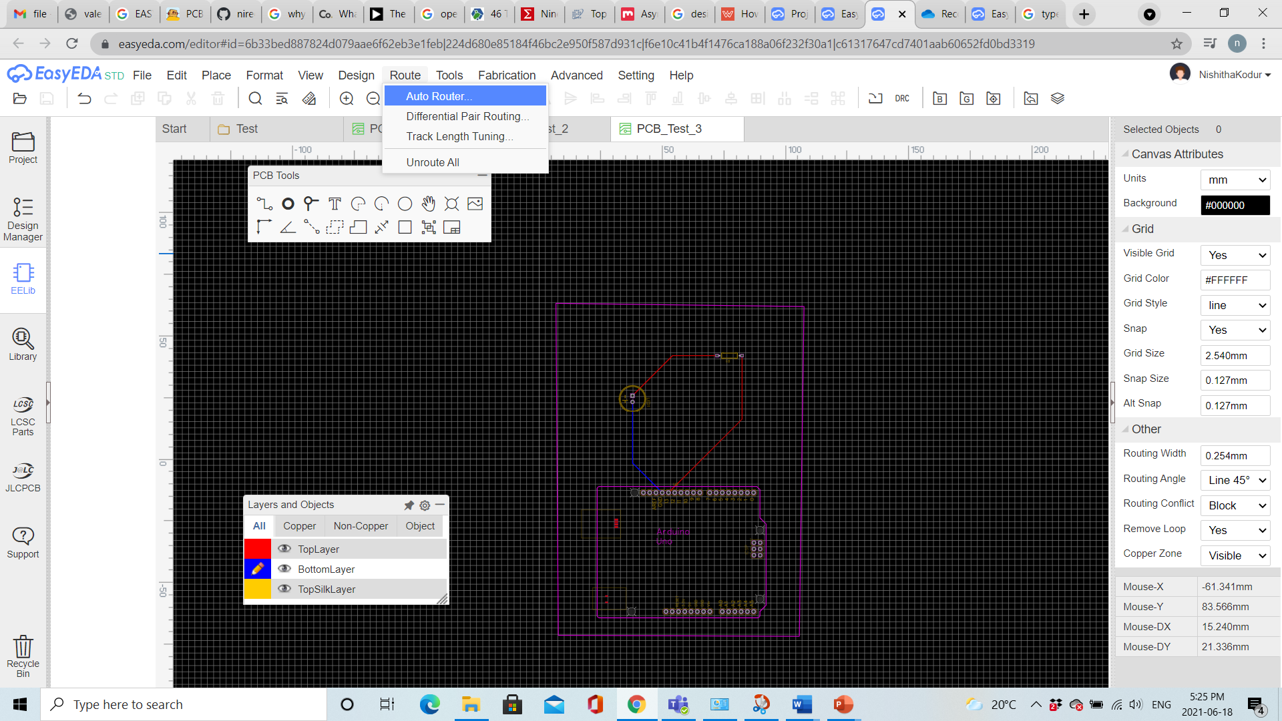
PCB Layout Design for the project
We also have an option of Auto Route, on selection, components are connected using tracks automatically if there are no errors.

Slide 21
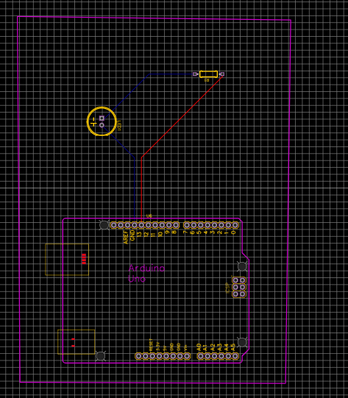
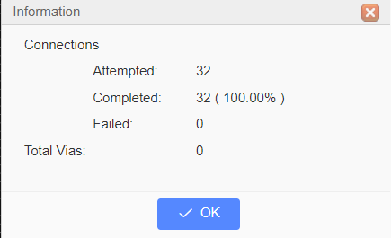
PCB Layout Design for the project
Once the routing is completed, we get a pop up with the below information. Also the circuit with Auto routed tracks.

Slide 22
PCB Layout Design for the project
We will be using two separate Zero-PCB boards for mounting our components:
LCD, Arduino and Potentiometer
Raspberry pi, Stepper driver and motors, PIR motion sensor, 12V DC Jack
These two boards can be connected together using the USB ports of Arduino Uno and Raspberry pi.
Alexa device can be connected to raspberry pi wirelessly. And, raspberry pi camera can be placed directly into the camera module, which does not require any soldering.

Slide 23
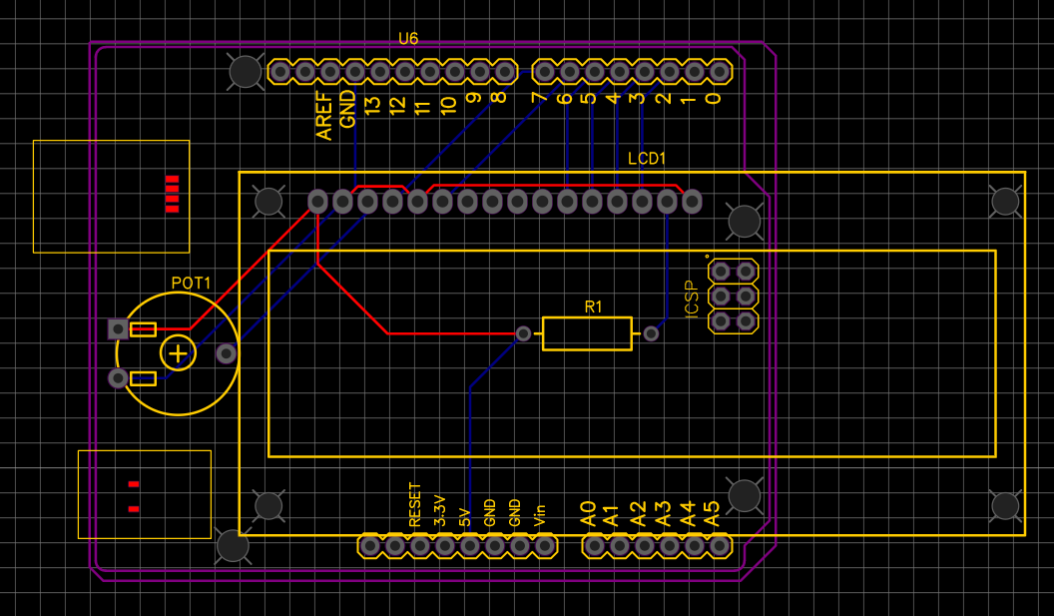
PCB Layout Design for the project
1st PCB Board:

Slide 24
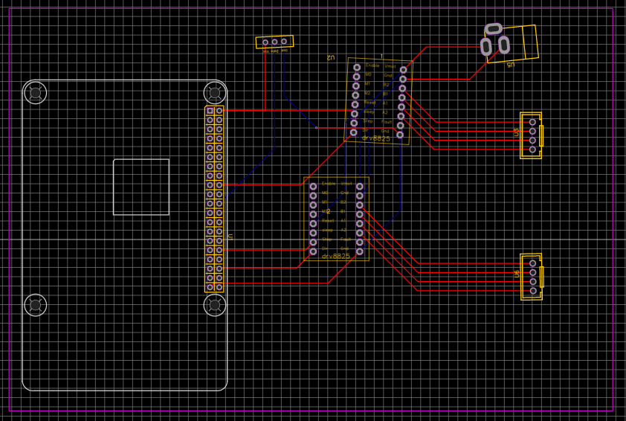
PCB Layout Design for the project
2nd PCB Board:

Slide 25
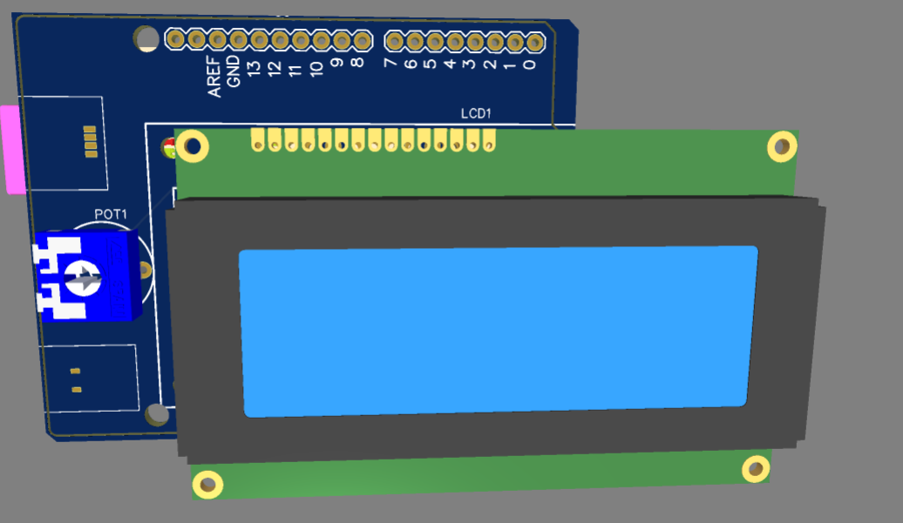
3D view of the design
1st PCB board:

Slide 26
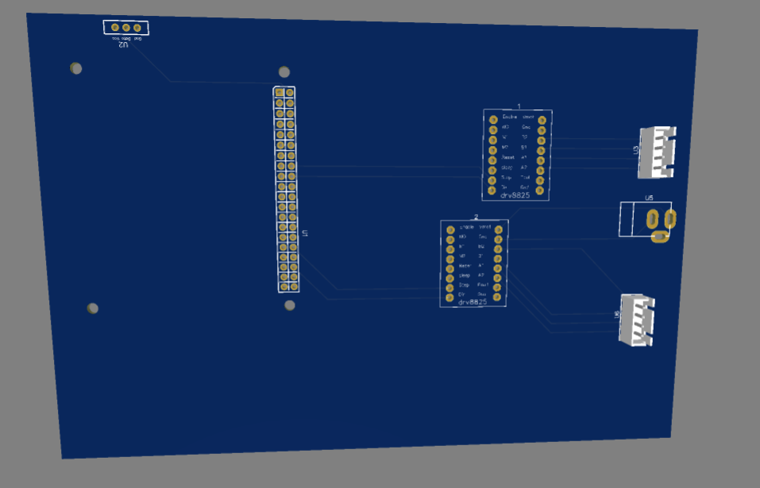
3D view of the design
2nd PCB Board:

Slide 27
References
Ayibiowu, A. (2019, 09 13). TOP 10 FREE PCB DESIGN SOFTWARE FOR 2019.
Retrieved from Electronics-lab.com: https://www.electronics-lab.com/top-10-free-pcb-design-software-2019/
Easyeda. (n.d.). Libraries.
Retrieved from EASYEDA: https://docs.easyeda.com/en/Schematic/Libraries/index.html
Fahad, E. (2020, October 18). Selecting a Power Supply for Raspberry Pi.
Retrieved from Electronic Clinic: https://www.electroniclinic.com/selecting-a-power-supply-for-raspberry-pi/
Hommer. (n.d.). How to Use EasyEDA to design PCB Schematic Step By Step.
Retrieved from WELLPCB: https://www.wellpcb.com/easyeda.html
Janstar. (2015). JanExampleCircuits.
Retrieved from EASYEDA: https://easyeda.com/janstar1122/jan_example_circuits-yjhN5dICw
Lim, A. (2019, January 29). What is a Schematic Diagram?
Retrieved from ThoughtCo.: https://www.thoughtco.com/what-is-a-schematic-diagram-4584811
Siva. (n.d.). PCB Designing using EasyEDA.
Retrieved from Instructables Circuits: https://www.instructables.com/PCB-Designing-Using-EasyEDA/

Slide 28
References
Digi-KeyElectronics. (n.d.). 2670Zero-PCB.
Retrieved from Digi-Key: https://www.digikey.ca/en/products/detail/adafruit-industries-llc/2670/7244957?utm_adgroup=Prototype%20Boards%20Perforated&utm_source=google&utm_medium=cpc&utm_campaign=Shopping_Product_Prototyping%2C%20Fabrication%20Products_NEW&utm_term=&productid=72449
EadyEDA. (n.d.). PCB Layout.
Retrieved from EasyEDA: https://docs.easyeda.com/en/Introduction/PCB-Layout/index.html
Electronicsforu. (2020, December 16). What Is Zero PCB Or Veroboard Mentioned In Your DIY articles?
Retrieved from Electronicsforu.com: https://www.electronicsforu.com/technology-trends/learn-electronics/veroboard-zero-pcb-difference

Slide 29
THANK YOU

Slide 30
QUERIES?

